Slide 1
New Ultrasound Images: Overview & Running Models
Capstone Meeting: November 6, 2024

Slide 2
New Images: Overview
Unlike the old set of images, the new set of images are batch-labeled based on the video they were extracted from. All images are considered to be “good quality”
Total Images: 681
Fluid Positive: 395
Spinal CONUS + Fluid: 98
Spinal Cord + Fluid: 188
Initial Question: Are all images actually high-quality / are the labels correct?

Slide 3
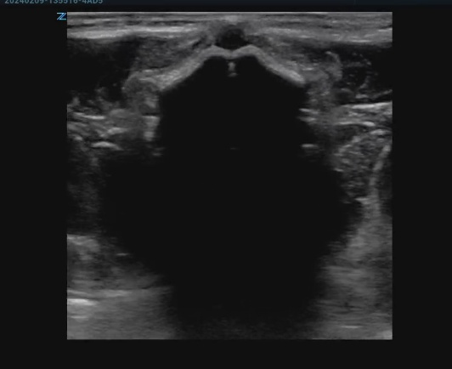
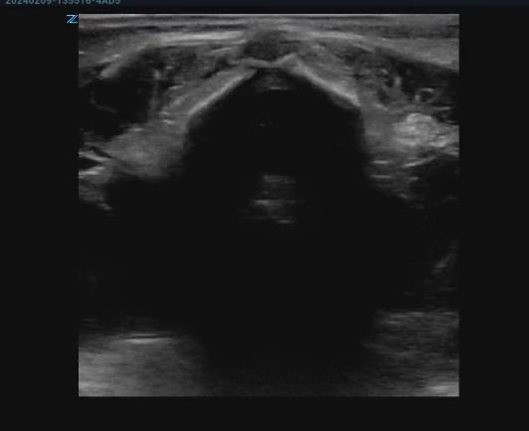
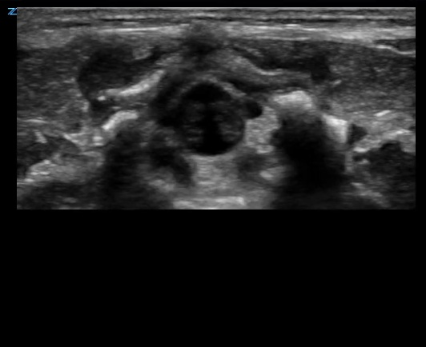
New Images: Manual Review
Upon manual review, not all the images did seem to be correctly labeled, or had other concerns:
Source Folder: 202402091355350041ABD_crop
Current Label: Fluid Positive
Source Folder: 202402091355470042ABD_crop
Current Label: Fluid Positive
Source Folder: 200106061017230020SMP_crop
Current Label: Fluid Positive

Slide 4
New Images: Manual Review Overview
Images with such concerns were totaled, based on the type of concern
Vertebral Space Obscured: 25 total images
Image Half-Cropped: 54 total images
Total Images with Concerns: 79 / 681 (11.6%)
Question: How should we handle these images?
Currently they are being included for model training / testing, but can be removed if needed
Can also change the quality label of these images to “Bad Quality”

